Slide 1
Project Stakeholders Presentation: Project Resource Re-allocation Across the Portfolio Recommended to Reduce Schedule Risk

Slide 2

Recommendation: Immediate resource reallocation to reduce portfolio risk
•Two of the projects in the portfolio (Projects D and E) have significantly underutilized resources but are currently mostly on schedule
•Project C is well behind schedule and at significant risk for failure
•We recommend shifting underutilized resources from Projects D and E to Project C to reduce risk and help get Project C back on track

Slide 3
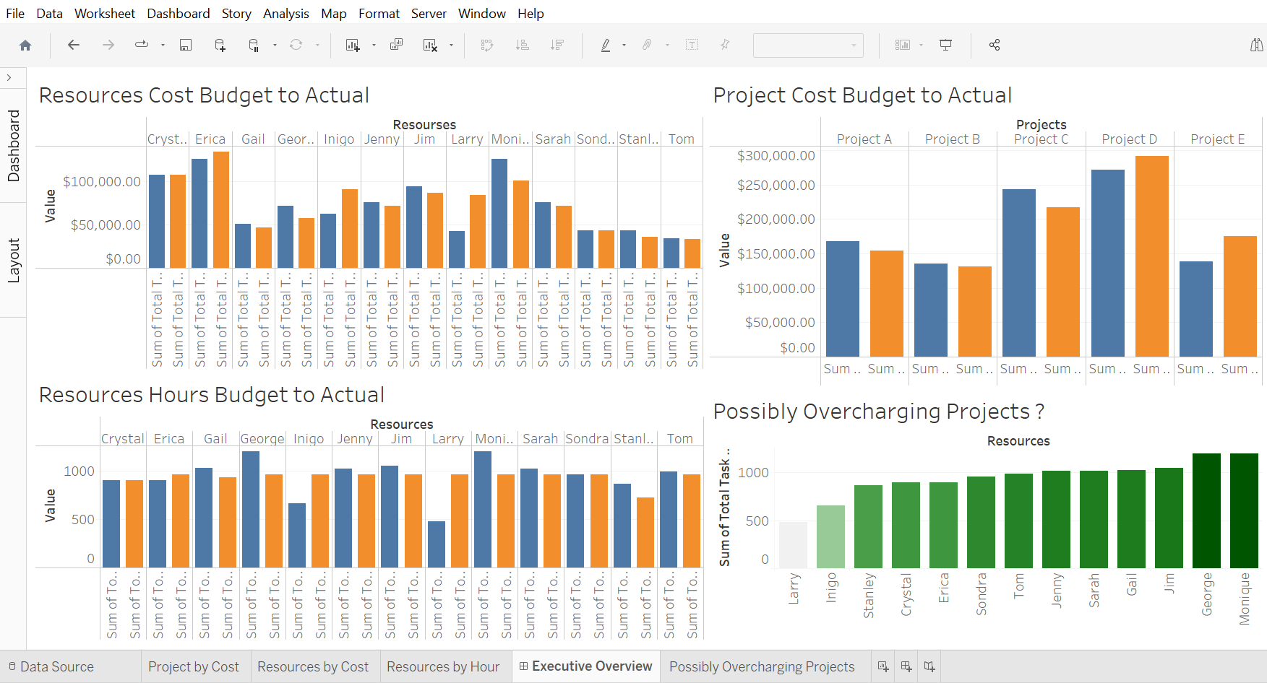
We collected and analyzed budget to actual data for hours and costs for resources assigned to all five projects in the portfolio, and then made that analysis available in a dashboard.
Observations :
Budget variances are currently roughly balancing each other across the portfolio, so the portfolio itself is roughly on budget
However, Project C is both over budget and well behind schedule, with a higher risk for failure than the rest of the portfolio
Two resources are currently charging significantly more than full time hours to the portfolio – this needs further investigation.

Slide 4
Insights Of Projects:
While Project C is over budget already, and significantly behind schedule, its success has been deemed important by the portfolio leaders, and as such efforts to mitigate risk and get the project back on track are warranted
Two of the projects in the portfolio (Projects D and E) have significantly underutilized resources but are currently mostly on schedule
Therefore we recommend shifting underutilized resources from Projects D and E to Project C to reduce risk and help get Project C back on track
Action Required: Portfolio-level decision by Program Leaders to reallocate resources across the portfolio.

